Slide 1
THE CAPSTONE PROJECT- 2 (Visualization) Title : Student Mental Health Tool : Power BI Batch : PGA-20 Under the Guidance of Arun Upadhyay Submitted by C ChandraMouli

Slide 2
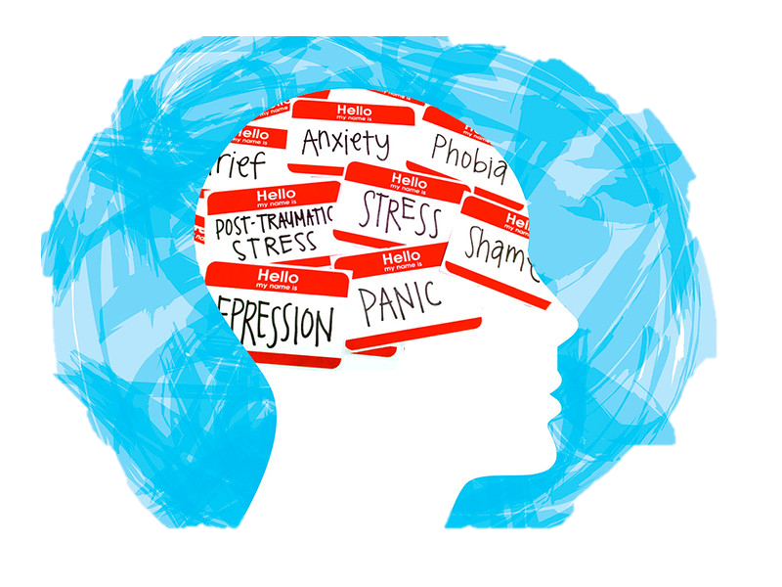
Contents
1. Introduction 2. Data Description 3. Pre-Processing 4. Ques to be answered 5. Insights 6. Conclusion

Slide 3

Introduction
Mental health determines how you think, feel and act. Good mental health is when you feel positive about yourself and cope well with the everyday pressures. If you experience issues dealing with everyday problems, it could be a sign of a mental health problem and should be addressed immediately.
According to the World Health Organization (WHO), “mental health is a state of well-being that enables people to cope with the stresses of life, realize their abilities, learn and work well, and contribute to their community.”

Slide 4

Pre-Processing Steps
The new variable Average CGPA has been created by using the CGPA
Other than that the data doesn't need any further steps in the data pre processing.
The data is suitable to proceed with the data analysis steps.

Slide 5
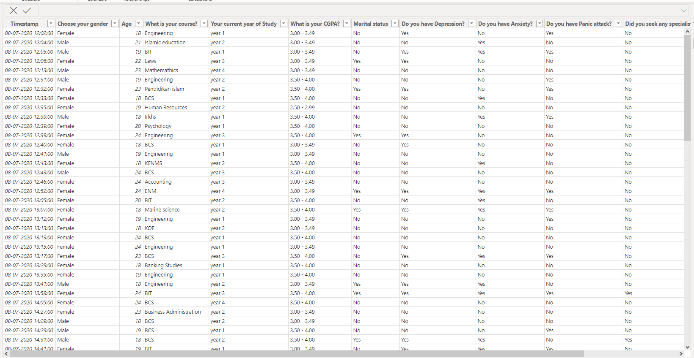
Tabular data

Slide 6
Questions
Which age group is most effected by anxiety, depression, panic attack.
Which gender effected the most.
Is there any relation between the health condition and CGPA
Which course comprises of most of the mental health conditions.
How many students seek for the specialist treatment

Slide 7
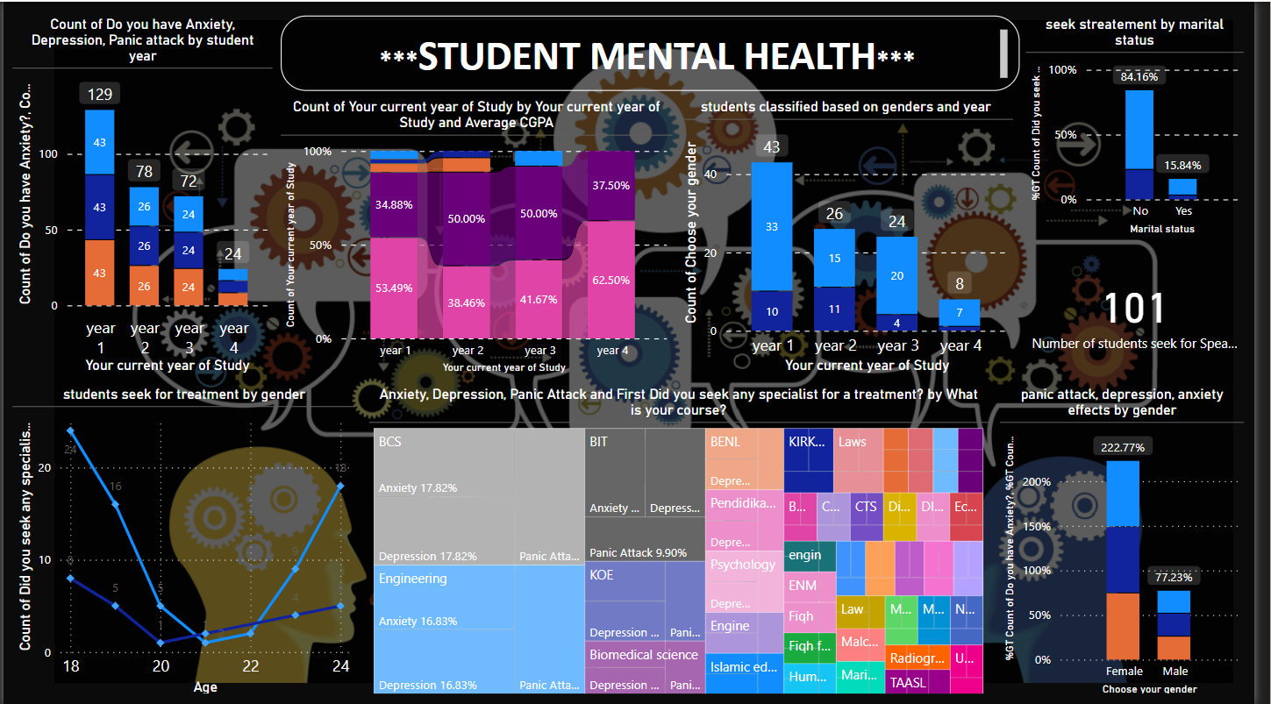

Slide 8
Insights
Year 1 students are the most effected with anxiety, depression and panic attacks.
All the students seek for the specialist treatment.
Among the male and female , females are more prone for the metal health conditions.
Most of the students marital students the marital status is NO
The Year 4 students shows the less prine to the mental health conditions
the major leap in the cases is seen in case of athe first year students
The vide veriety f CGPA is senn in the 1st yr stuents

Slide 9

Thank You..

